Slide 1
Some Commands used in Networking

Slide 2
Ping, Ipconfig
Three TCP/IP utilities used to solve problems with TCP/IP and communicate on a TCP/IP network are Ping, Ipconfig.
The Ping (Packet InterNet Groper) command tests connectivity by sending an echo request to a remote computer. If the remote computer is online and detects the signal, it responds to the ping.
When testing for connectivity or problems with name resolution, Ping should be the first tool you use.

Slide 3
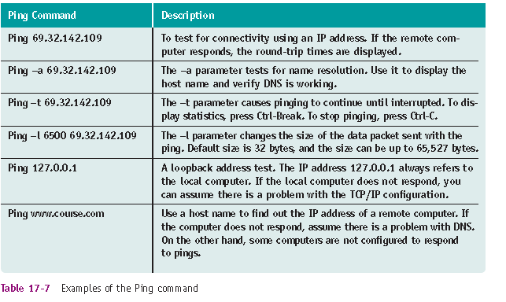
ping

Slide 4
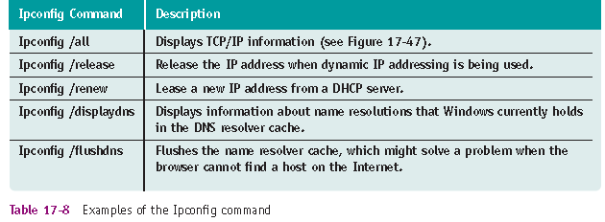
Use IPCONFIG to troubleshoot TCP/IP Configuration
The Ipconfig command can display TCP/IP configuration information and refresh the IP address.

Slide 5
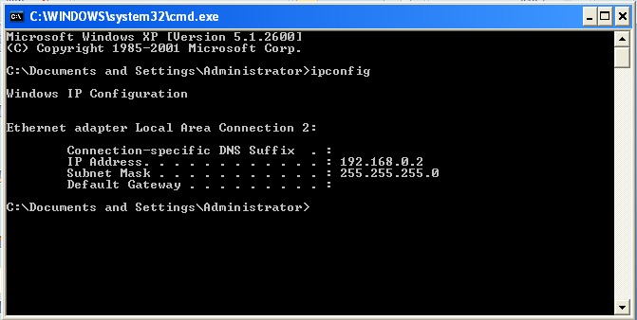
Check IP Configurations in Command Prompt

Slide 6
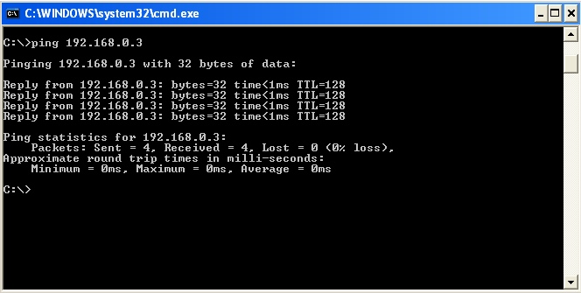
Using “ping’ command

Slide 7
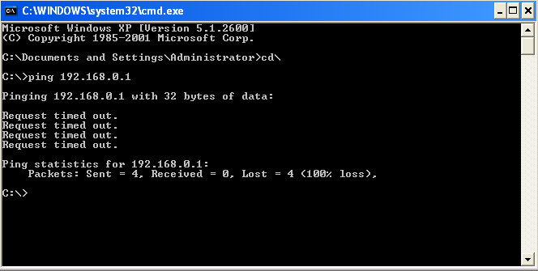
Using “ping’ command (IP address is not exist)

Slide 8
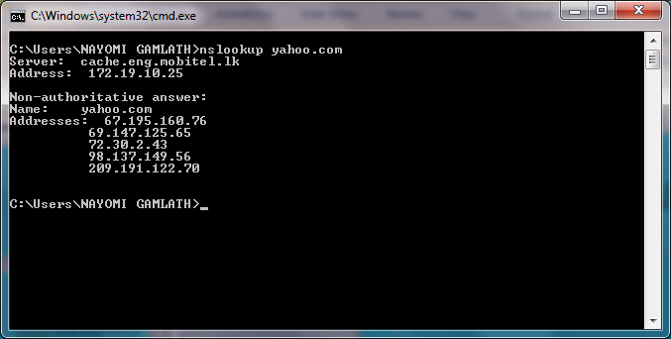
nslookup

Slide 9
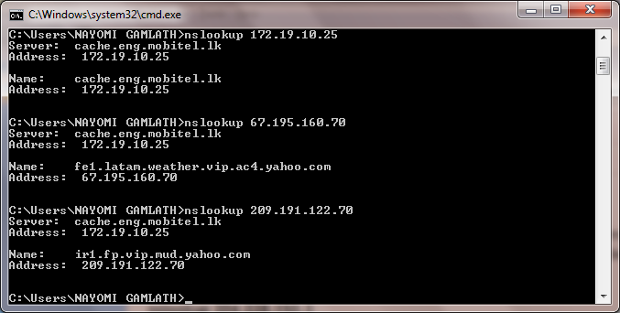
nslookup

Slide 10
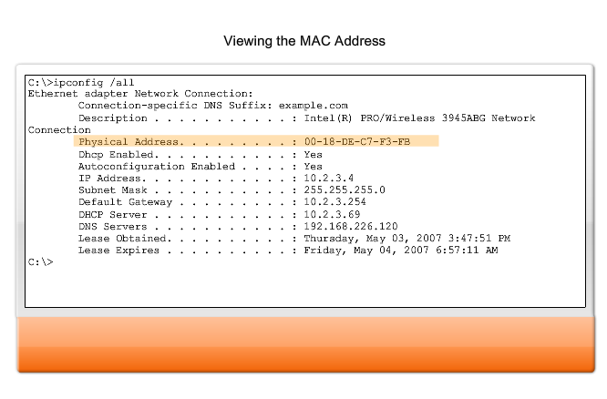
Viewing MAC address of your computer
A tool to examine the MAC address of our computer is the ipconfig /all or ifconfig. In the graphic, notice the MAC address of this computer

Slide 11
tracert
traceroute (tracert)is a computer network diagnostic tool for displaying the route (path) and measuring transit delays of packets across an Internet Protocol (IP) network.
use to visually see a network packet being sent and received and the amount of hops required for that packet to get to its destination.

Slide 12
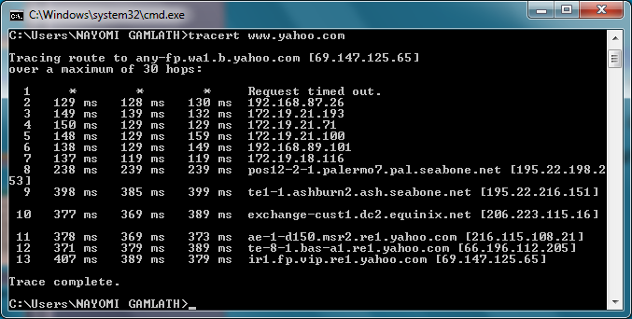
tracert

Slide 13
Sharing a Folder in network
Create a folder (named share1)
Right click on the that folder and select option “Sharing and security”

Slide 14
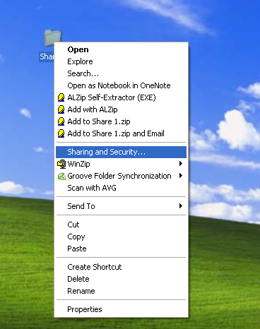
Sharing a Folder

Slide 15
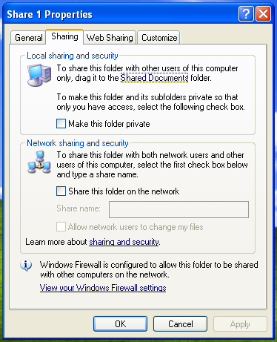
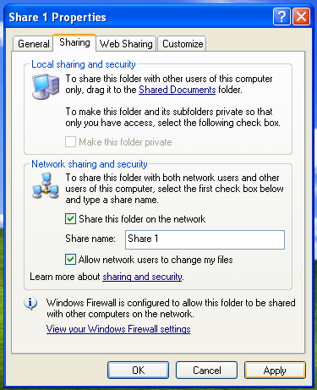
Sharing a Folder

